Slide 1
Chapter 9 – Classification and Regression Trees
Data Mining for Business Analytics in Python
Shmueli, Bruce, Gedeck & Patel

Slide 2
Trees and Rules
Goal: Classify or predict an outcome based on a set of predictors
The output is a set of rules
Example:
Goal: classify a record as “will accept credit card offer” or “will not accept”
Rule might be “IF (Income >= 106) AND (Education < 1.5) AND (Family <= 2.5) THEN Class = 0 (nonacceptor)
Also called CART, Decision Trees, or just Trees
Rules are represented by tree diagrams

Slide 3
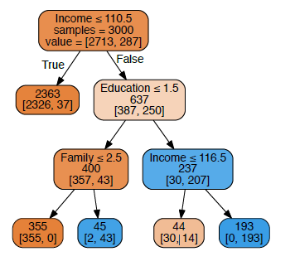
Example Tree: Classify Classify Bank Customers as Loan Acceptors Y/N

Slide 4
Import Needed Functionality
import pandas as pd
import numpy as np
from sklearn.tree import DecisionTreeClassifier,
DecisionTreeRegressor
from sklearn.ensemble import RandomForestClassifier,
GradientBoostingClassifier
from sklearn.model_selection import train_test_split,
cross_val_score, GridSearchCV
import matplotlib.pylab as plt
from dmba import plotDecisionTree,
classificationSummary, regressionSummary

Slide 5
How Is the Tree Produced?
Recursive partitioning: Repeatedly split the records into two parts so as to achieve maximum homogeneity of outcome within each new part
Stopping Tree Growth: A fully grown tree is too complex and will overfit

Slide 6
Recursive Partitioning

Slide 7
Recursive Partitioning Steps
Pick one of the predictor variables, x_{i}
Pick a value of x_{i,} say s_{i}, that divides the training data into two (not necessarily equal) portions
Measure how “pure” or homogeneous each of the resulting portions is
“Pure” = containing records of mostly one class (or, for prediction, records with similar outcome values)
Algorithm tries different values of x_{i,} and s_{i} to maximize purity in initial split
After you get a “maximum purity” split, repeat the process for a second split (on any variable), and so on

Slide 8
Example: Riding Mowers
Goal: Classify 24 households as owning or not owning riding mowers
Predictors = Income, Lot Size
library rpart for running trees, function prp in library rpart.plot to plot them

Slide 9
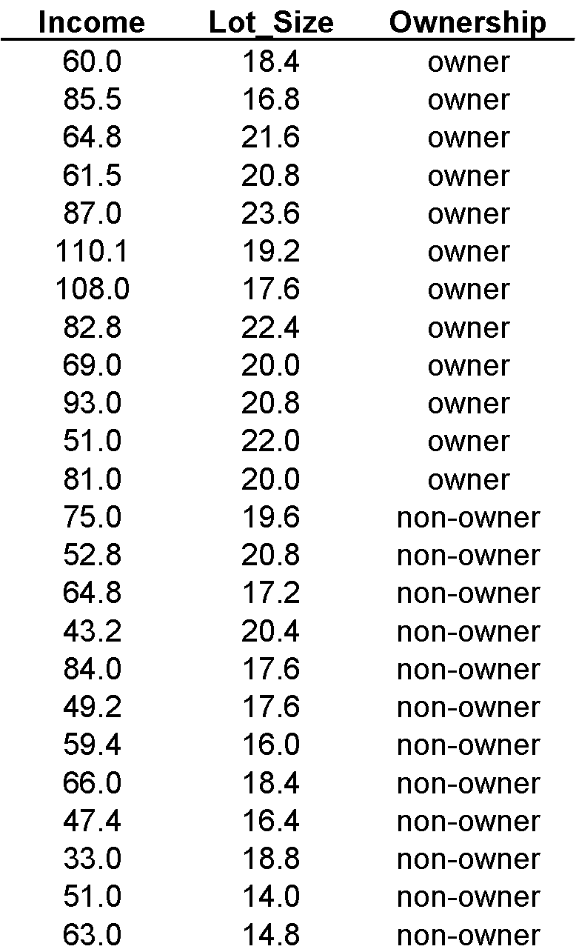

Slide 10
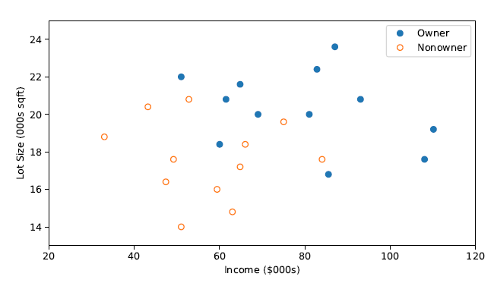

Slide 11
How to split
Order records according to one variable, say income
Take a predictor value, say 59.7 (the first record) and divide records into those with income >= 59.7 and those < 59.7
Measure resulting purity (homogeneity) of class in each resulting portion
Try all other split values
Repeat for other variable(s)
Select the one variable & split that yields the most purity

Slide 12
Note: Categorical Variables
Examine all possible ways in which the categories can be split.
E.g., categories A, B, C can be split 3 ways
{A} and {B, C}
{B} and {A, C}
{C} and {A, B}
With many categories, # of splits becomes huge

Slide 13
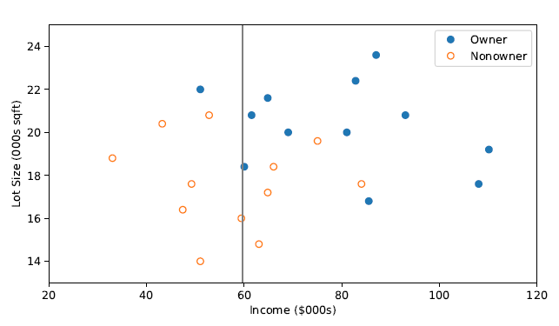
The first split: Income = 59.7

Slide 14
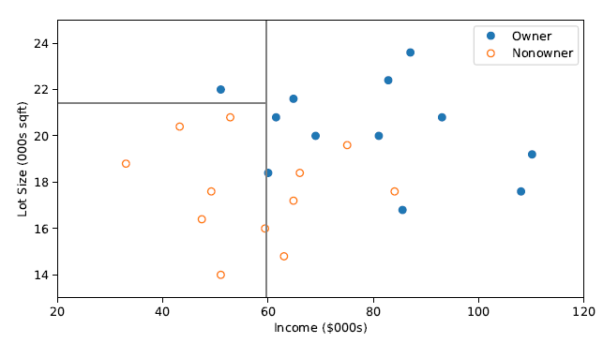
Second Split: Lot size = 21.4

Slide 15
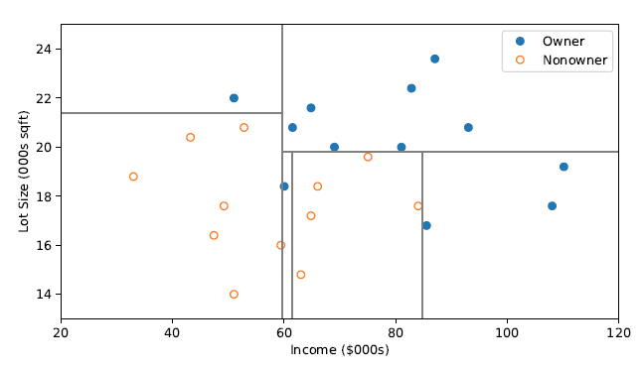
After All Splits

Slide 16
Measuring Impurity

Slide 17
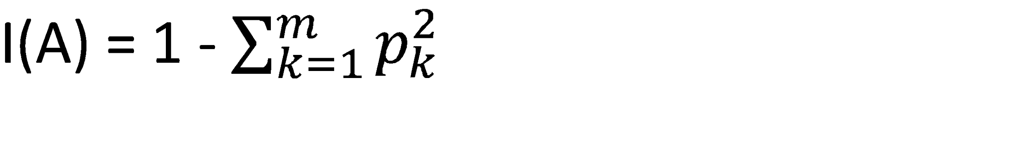
Gini Index
Gini Index for rectangle A
p = proportion of cases in rectangle A that belong to class k (out of m classes)
I(A) = 0 when all cases belong to same class
Max value when all classes are equally represented (= 0.50 in binary case)

Slide 18
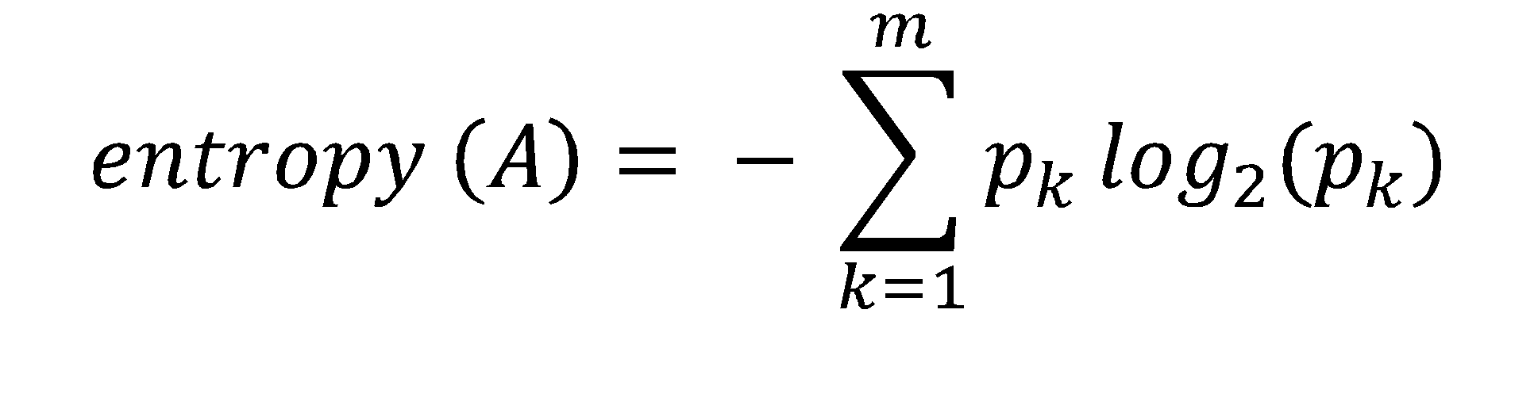
Entropy
p = proportion of cases in rectangle A that belong to class k (out of m classes)
Entropy ranges between 0 (most pure) and log₂(m) (equal representation of classes)

Slide 19
Impurity and Recursive Partitioning
Obtain overall impurity measure (weighted avg. of individual rectangles)
At each successive stage, compare this measure across all possible splits in all variables
Choose the split that reduces impurity the most
Chosen split points become nodes on the tree

Slide 20
Running the Classification Tree
mower_df = pd.read_csv('RidingMowers.csv')
# use max_depth to control tree size (None = full tree)
classTree = DecisionTreeClassifier(random_state=0,
max_depth=1)
classTree.fit(mower_df.drop(columns=['Ownership']),
mower_df['Ownership'])
print("Classes: {}".format(', '.join(classTree.classes_)))
plotDecisionTree(classTree,feature_names=mower_df.columns[:2],
class_names=classTree.classes_))

Slide 21
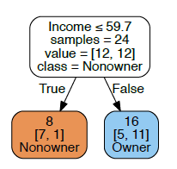
First Split – The Tree

Slide 22
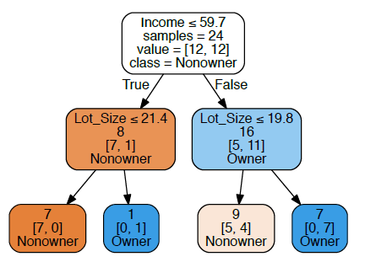
Tree After 3 Splits
The first split is on Income, then the next split is on Lot Size for both the low income group (at lot size 21.4) and the high income split (at lot size 19.8)

Slide 23
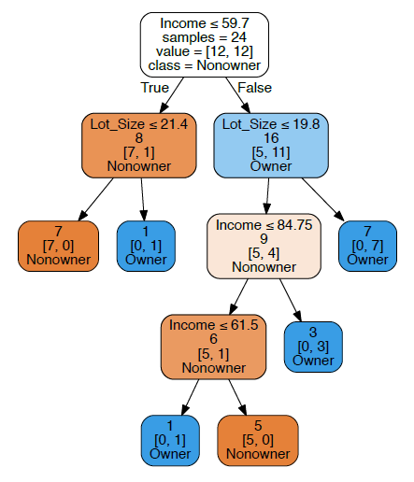
Tree After All Splits
Decision node
Terminal node (leaf)

Slide 24
The dominant class in this portion of the first split (those with income >= 59.7) is “owner” – 11 owners and 5 non-owners
The next split for this group of 16 will be on the basis of Income, splitting at 84.75

Slide 25
Read down the tree to derive rules
If Income <= 59.7 AND
Lot Size <= 21.4,
classify as “Nonowner”

Slide 26
The Overfitting Problem

Slide 27
Full trees are complex and overfit the data
Natural end of process is 100% purity in each leaf
This overfits the data, which end up fitting noise in the data
Consider Example 2, Loan Acceptance with more records and more variables than the Riding Mower data – the full tree is very complex

Slide 28
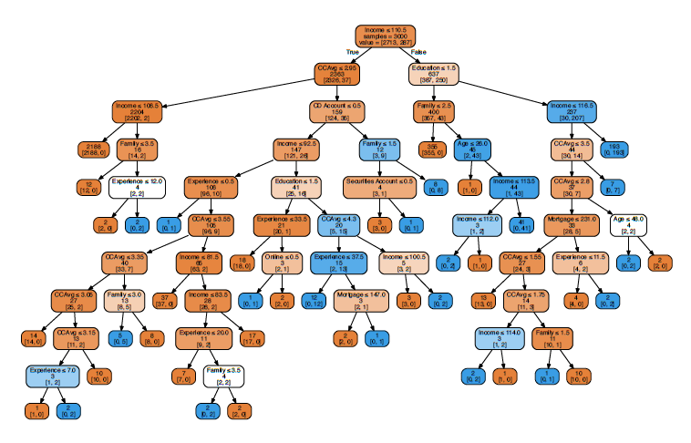
Full trees are too complex – they end up fitting noise, overfitting the data

Slide 29


Trees can also be unstable
If 2 or more variables are of roughly equal importance, which one CART chooses for the first split can depend on the initial partition into training and validation
A different partition into training/validation could lead to a different initial split
This can cascade down and produce a very different tree from the first training/validation partition
Solution is to try many different training/validation splits – “cross validation”

Slide 30
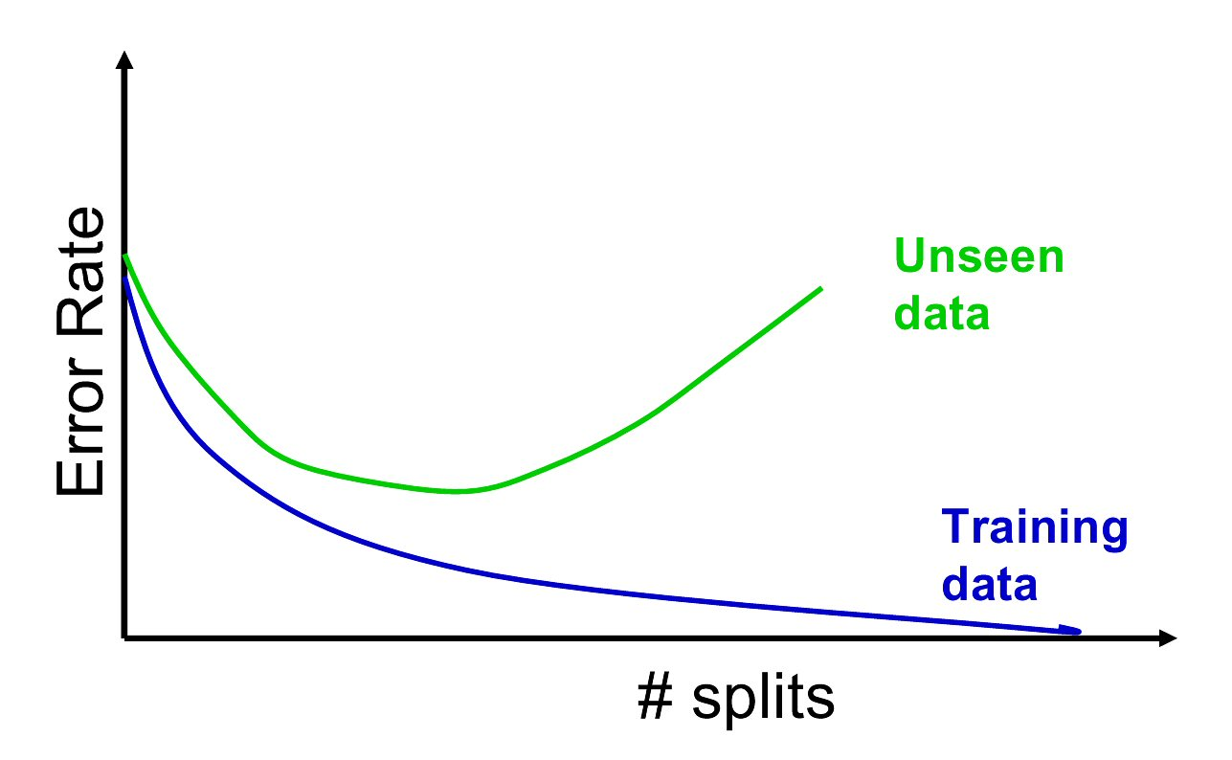
Overfitting & instability produce poor predictive performance – past a certain point in tree complexity, the error rate on new data starts to increase

Slide 31
Assessing Tree Performance
classificationSummary(train_y, FullClassTree.predict(train_X))
classificationSummary(valid_y, fullClassTree.predict(valid_X))
Output
# full tree: training
Confusion Matrix (Accuracy 1.0000)
Prediction
Actual 0 1
0 2727 0
1 0 273
# full tree: validation
Confusion Matrix (Accuracy 0.9790)
Prediction
Actual 0 1
0 1790 17
1 25 168

Slide 32
Limiting Tree Growth
In DecisionTreeClassifier() we can control
Tree depth
Minimum number of records in split nodes
Minimum number of records in terminal node
Minimum impurity increase needed
But what are optimal values for these parameters?

Slide 33
With cross validation (CV), test multiple trees
Partition data into sets (folds) for model-fitting, and data for evaluating
Fit model with training fold, and evaluate with holdout fold
Repeat, typically with evaluation folds that are non-overlapping and smaller than training folds
e.g. 5-fold CV fits 5 models, each evaluated on 20% of the data that is held out, with each set of evaluation data non-overlapping with the others

Slide 34
Exhaustive GridsearchCV for Most Accurate Parameters
Use GridsearchCV on training data, coupled with cross-validation.
Exhaustively build trees using different values for the parameters, using the training fold
Measure accuracy on the holdout fold
Choose tree with best performance
Assess its performance on the validation data, not used at all to this point

Slide 35
RandomizedSearchCV() as alternative to exhaustive search
GridsearchCV can be prohibitively time-consuming if many parameters are involved.
Randomized Search(CV) is alternative
Randomly selects from set of possible parameter combinations
Use n_iter to set the number of permitted iterations

Slide 36
GridSearchCV() code
# Start with an initial guess for parameters
param_grid = {
'max_depth': [10, 20, 30, 40],
'min_samples_split': [20, 40, 60, 80, 100],
'min_impurity_decrease': [0, 0.0005, 0.001, 0.005, 0.01],
}
# Which values are best?
# n_jobs=-1 will utilize all available CPUs
gridSearch = GridSearchCV(DecisionTreeClassifier(random_state=1),
param_grid, cv=5, n_jobs=-1)
gridSearch.fit(train_X, train_y)
print('Initial score: ', gridSearch.best_score_)
print('Initial parameters: ', gridSearch.best_params_)

Slide 37
GridSearchCV() code - refined
# Adapt grid based on result from initial grid search
param_grid = {
'max_depth': list(range(2, 16)), # 14 values
'min_samples_split': list(range(10, 22)), # 11 values
'min_impurity_decrease': [0.0009, 0.001, 0.0011], # 3 values
}
gridSearch = GridSearchCV(DecisionTreeClassifier(random_state=1),
param_grid, cv=5, n_jobs=-1)
gridSearch.fit(train_X, train_y)
print('Improved score: ', gridSearch.best_score_)
print('Improved parameters: ', gridSearch.best_params_)
bestClassTree = gridSearch.best_estimator_

Slide 38
Performance
# Results from initial guess at parameters
Initial score: 0.988
Initial parameters: {'max_depth': 10, 'min_impurity_decrease': 0.001,
'min_samples_split': 20}
# Results after second Gridsearch
Improved score: 0.9883333333333333
Improved parameters: {'max_depth': 5, 'min_impurity_decrease': 0.0011,
'min_samples_split': 13}

Slide 39
GridSearchCV() results
# Recall original full tree
# full tree: validation
Confusion Matrix (Accuracy 0.9790)
Prediction
Actual 0 1
0 1790 17
1 25 168
# Results after Gridsearch
# full tree: validation
Confusion Matrix (Accuracy 0.9825)
Prediction
Actual 0 1
0 1793 14
1 21 172

Slide 40
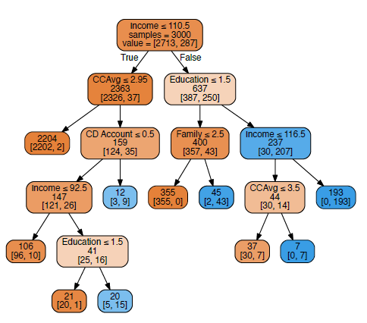
Resulting Tree

Slide 41
Regression Trees

Slide 42
Regression Tree is Similar, Except...
Prediction is computed as the average of numerical target variable in the rectangle (in CT it is majority vote)
Impurity measured by sum of squared deviations from leaf mean
Performance measured by RMSE (root mean squared error)

Slide 43
Ensembles
Prediction is computed as the average of numerical target variable in the rectangle (in CT it is majority vote)
Impurity measured by sum of squared deviations from leaf mean
Performance measured by RMSE (root mean squared error)

Slide 44
Ensemble Variants
Harness “wisdom of the crowd”
Random Forest
Boosted Trees

Slide 45
Random Forest
Draw multiple random samples from data (“bootstrap resampling”)
Fit tree to each resample using a random set of predictors
Combine the classifications/predictions from all the resampled trees (the “forest”) to obtain improved predictions
Basic idea: Taking an average of multiple estimates (models) is more reliable than just using a single estimate

Slide 46
Random Forest
bank_df = pd.read_csv('UniversalBank.csv')
bank_df.drop(columns=['ID', 'ZIP Code'], inplace=True)
X = bank_df.drop(columns=['Personal Loan'])
y = bank_df['Personal Loan']
train_X, valid_X, train_y, valid_y = train_test_split(X, y,
test_size=0.4, random_state=1)
rf = RandomForestClassifier(n_estimators=500,
random_state=1)
rf.fit(train_X, train_y)

Slide 47
Variable Importance
Each variable is used by some trees and not others
We can, therefore, measure each variable’s contribution to reducing impurity (reduction in Gini Index)
This is the variable importance score

Slide 48
Variable Importance, code
# variable (feature) importance plot
importances = rf.feature_importances_
std = np.std([tree.feature_importances_ for tree in
rf.estimators_], axis=0)
df = pd.DataFrame({'feature': train_X.columns,
'importance': importances, 'std': std})
df = df.sort_values('importance')
print(df)
ax = df.plot(kind='barh', xerr='std', x='feature',
legend=False)
ax.set_ylabel('')
plt.show()

Slide 49
Variable Importance scores
and their variability across trees
Output
feature importance std
7 Securities Account 0.003964 0.004998
9 Online 0.006394 0.005350
10 CreditCard 0.007678 0.007053
6 Mortgage 0.034243 0.023469
1 Experience 0.035539 0.016061
0 Age 0.036258 0.015858
8 CD Account 0.057917 0.043185
3 Family 0.111375 0.053146
4 CCAvg 0.172105 0.103011
5 Education 0.200772 0.101002
2 Income 0.333756 0.129227

Slide 50
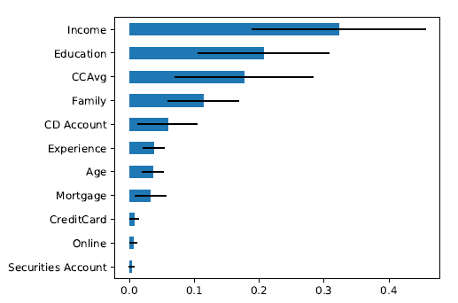
Variable Importance Plot

Slide 51
Boosted Trees
Fits a succession of single trees
Each successive fit up-weights the misclassified records from prior stage
You now have a set of classifications or predictions, one from each tree
Use weighted voting for classification, weighted average for prediction, higher weights to later trees

Slide 52
Boosted Trees
Especially useful for the “rare case” scenario (suppose 1’s are the rare class)
With simple classifiers, it can be hard for a “1” to “break out” from the dominant classification, & many get misclassified
Up-weighting them focuses the tree fitting on the 1’s, and reduces the dominating effect of the 0’s

Slide 53
Boosted Trees - Performance
boost = GradientBoostingClassifier()
boost.fit(train_X, train_y)
classificationSummary(valid_y, boost.predict(valid_X))
Output
Confusion Matrix (Accuracy 0.9835)
Prediction
Actual 0 1
0 1799 8
1 25 168

Slide 54
Advantages of trees
Easy to use, understand
Single trees produce rules that are easy to interpret & implement
Variable selection & reduction is automatic
Do not require the assumptions of statistical models
Can work without extensive handling of missing data
Disadvantage of single trees: instability and poor predictive performance

Slide 55
Summary
Classification and Regression Trees are an easily understandable and transparent method for predicting or classifying new records
A single tree is a graphical representation of a set of rules
Tree growth must be stopped to avoid overfitting of the training data – use GridsearchCV
Ensembles (random forests, boosting) improve predictive performance, but you lose interpretability and the rules embodied in a single tree

